Slide 1

Business Communication
Md. Taslim Hosen Shanto

Slide 2

Presentation Outline
What is Communication?
Essentials of workplace communication
How to chose the right communication Medium
Clarifying the objectives
Elements of verbal Communications
Email etiquettes

Slide 3





Effective communication is essential for being proactive at work as it facilitates information sharing, collaboration, and the expression of ideas and feedback.
3

Slide 4
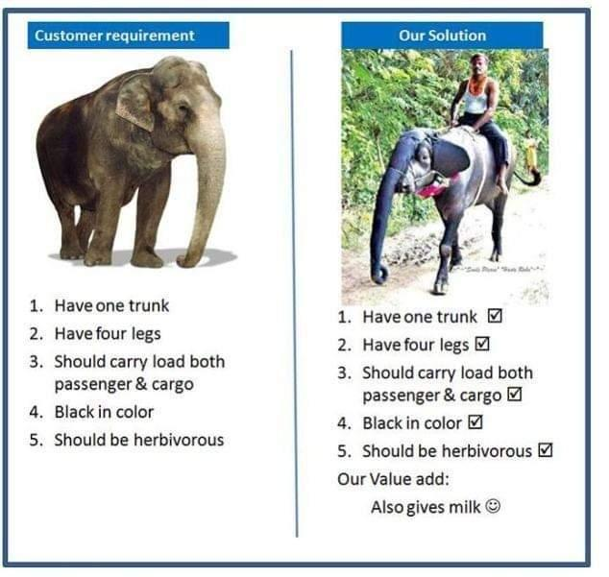
Example of Poor Communication
4

Slide 5
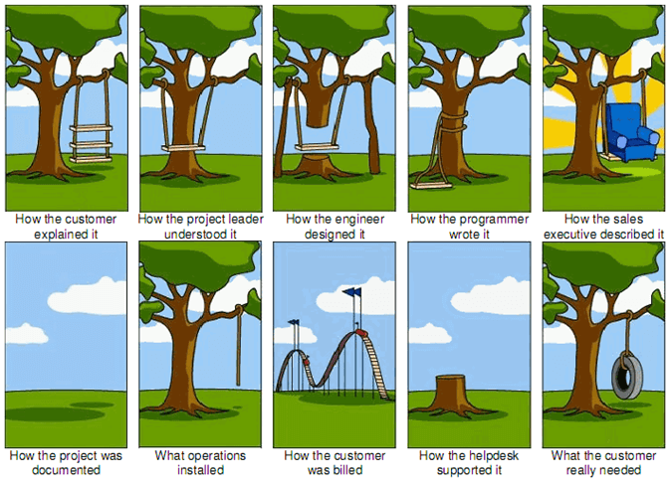
Example of Poor Communication
5

Slide 6
Three Basic Essentials For Workplace Communication
Look at situations from the other person(s) perspective
Choose the right communication medium
Be clear with your objective
6

Slide 7
Communication Mediums
Face-to-Face Communication
Phone /Video chat
Text/Chat
Email
Meetings
7

Slide 8


Choosing the right Communication Medium
What is the best communication medium to use?
8

Slide 9

Be Clear With Your Objective
Your OBJECTIVE is simply your goal
Being clear with your objective is crucial for effective communication and proactive action, as it helps you articulate your goals, align others' understanding, and focus your efforts toward achieving desired outcomes.
9

Slide 10

Look At Situations From The Other Person’s Perspective
Consider others' perspectives to be proactive at work by fostering empathy, effective communication, and collaborative problem-solving.
10

Slide 11
Verbal & Nonverbal
Communication at Workplace
Choose your words wisely
Listen actively
Tone of voice
Body language and non-verbal cues
11

Slide 12

Email Etiquettes
Use a professional email address
Use a clear and concise subject line
Use a professional greeting
Keep it concise and focused
Use proper language and tone
Be mindful of your formatting
Proofread before sending
Use a professional email signature
Be cautious with attachments
Use appropriate salutations and sign-offs
12

Slide 13


THANK YOU

